Slide 1
Introduction to Merging and Joining Datasets

Slide 2
Merging and joining datasets are crucial techniques in data analysis that allow you to integrate information from multiple sources. These operations enable analysts and data scientists to create richer datasets that facilitate deeper insights and more comprehensive analyses.
We We can join, merge, and concat dataframe using different methods.
In Dataframe df.merge(),df.join(), and df.concat() methods help in joining, merging and concating different dataframe.

Slide 3
Concatenating DataFrame
In order to concat dataframe, we use concat() function which helps in concatenating a dataframe. We can concat a dataframe in many different ways, they are:
Concatenating DataFrame using .concat()
Concatenating DataFrame by setting logic on axes
Concatenating DataFrame using .append()
Concatenating DataFrame by ignoring indexes
Concatenating DataFrame with group keys

Slide 4
Concatenating DataFrame using .concat() :
In order to concat a dataframe, we use .concat() function this function concat a dataframe and returns a new dataframe.

Slide 5
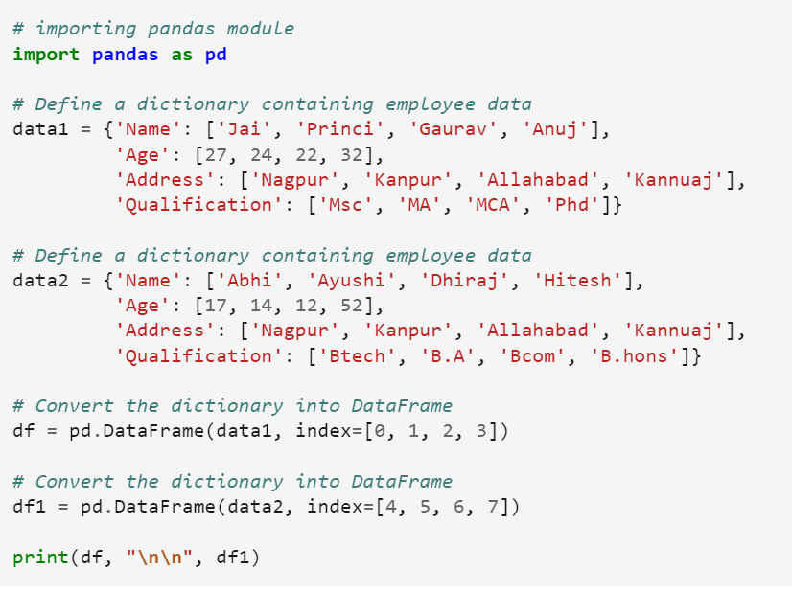

Slide 6
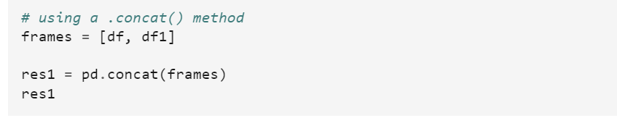
Now we apply .concat function in order to concat two dataframe.

Slide 7
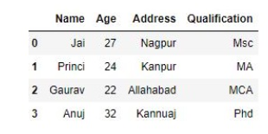
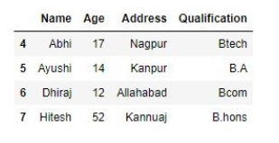
Output :
As shown in the output image, we have created two dataframe after concatenating we get one dataframe.

Slide 8
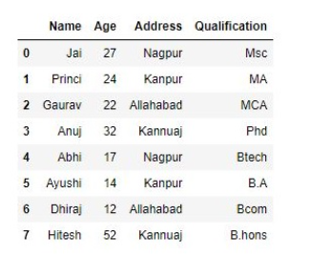

Slide 9
Concatenating DataFrame by setting logic on axes :
In order to concat dataframe, we have to set different logic on axes. We can set axes in the following three ways:
Taking the union of them all, join='outer'. This is the default option as it results in zero information loss.
Taking the intersection, join='inner'.
Use a specific index, as passed to the join_axes argument.

Slide 10
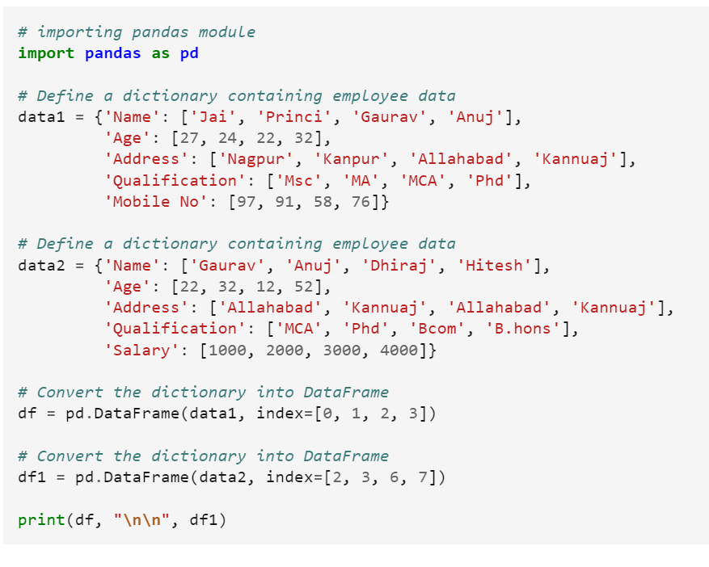

Slide 11
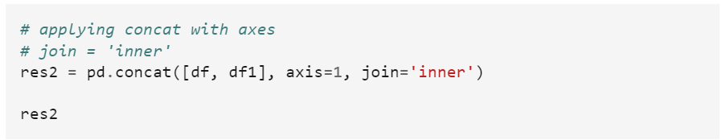
Now we set axes join = inner for intersection of dataframe.

Slide 12
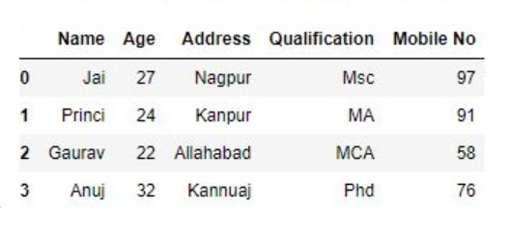
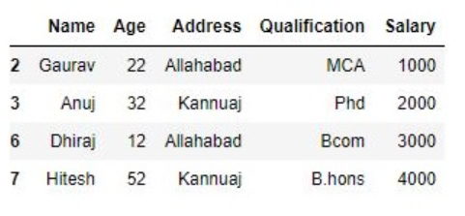
Output : As shown in the output image, we get the intersection of dataframe.

Slide 13
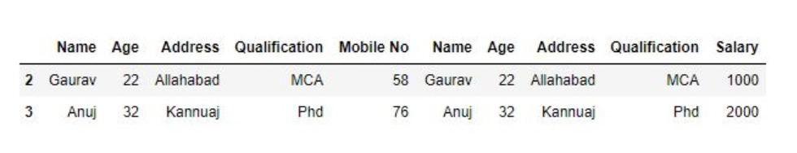

Slide 14
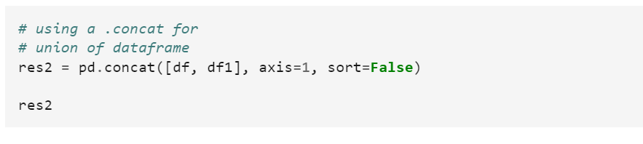
Now we set axes join = outer for union of dataframe.

Slide 15
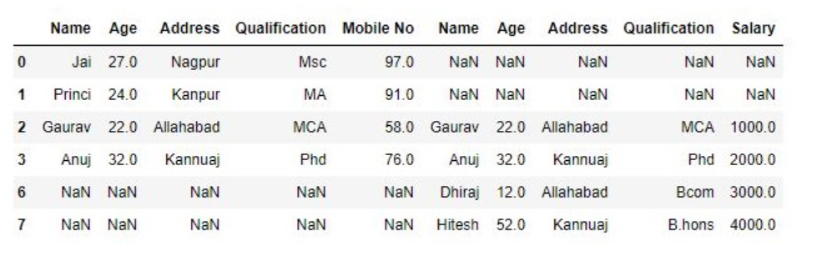
Output : As shown in the output image, we get the union of dataframe

Slide 16
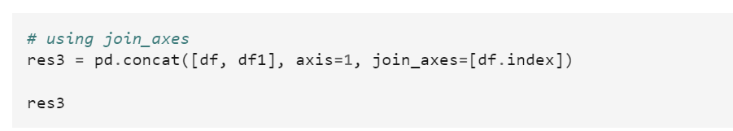
Now we used a specific index, as passed to the join_axes argument

Slide 17
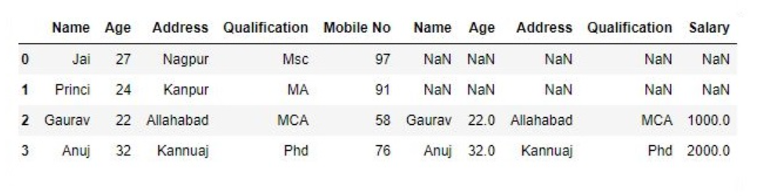

Slide 18
Concatenating DataFrame using .append()
In order to concat a dataframe, we use .append() function this function concatenate along axis=0, namely the index. This function exist before .concat.

Slide 19
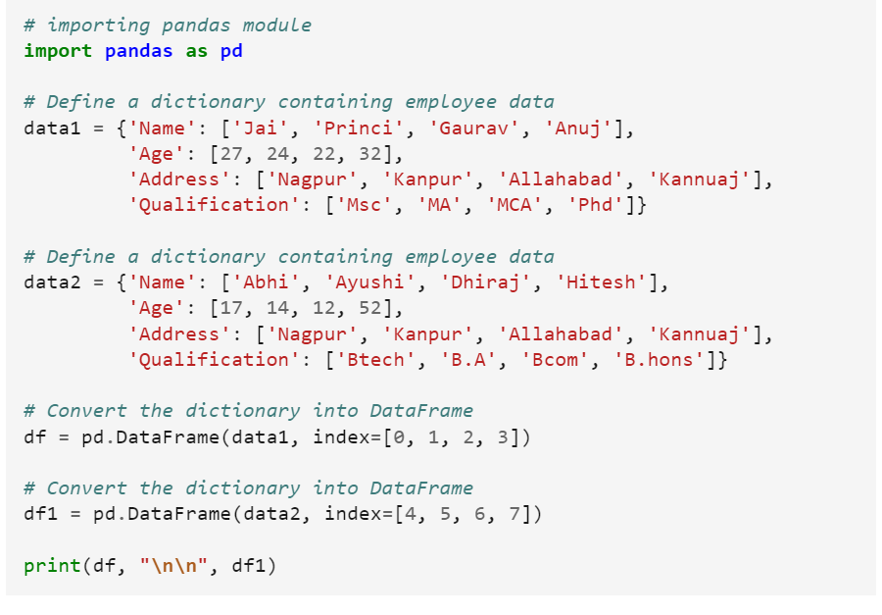

Slide 20
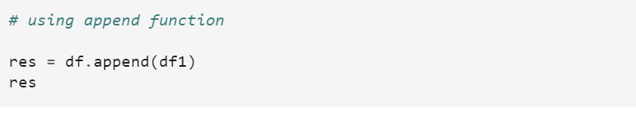
Now we apply .append() function inorder to concat to dataframe

Slide 21
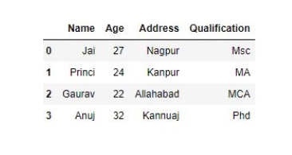
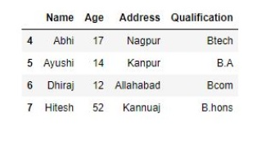

Slide 22
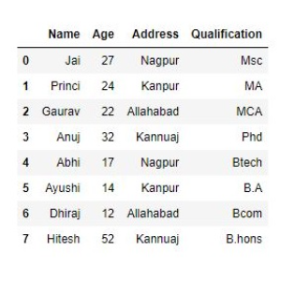

Slide 23
Concatenating DataFrame by ignoring indexes :
In order to concat a dataframe by ignoring indexes, we ignore index which don’t have a meaningful meaning, you may wish to append them and ignore the fact that they may have overlapping indexes. In order to do that we use ignore_index as an argument.

Slide 24
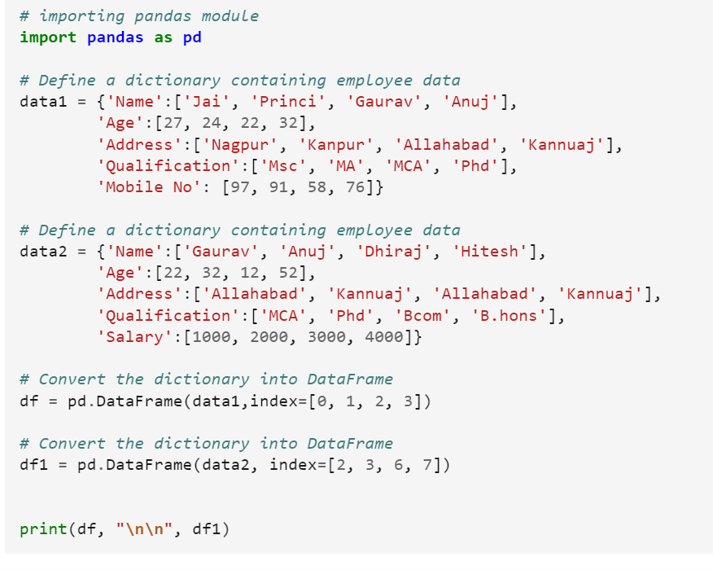

Slide 25
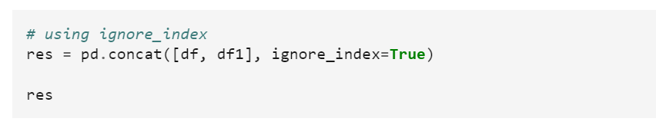
Now we are going to apply ignore_index as an argument.

Slide 26
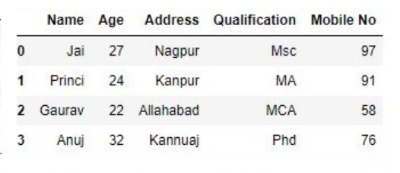
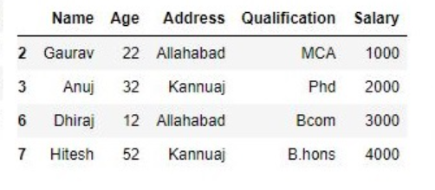

Slide 27
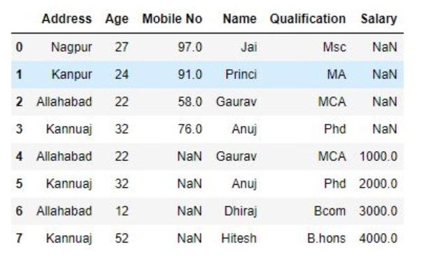

Slide 28
Concatenating DataFrame with group keys :
In order to concat dataframe with group keys, we override the column names with the use of the keys argument. Keys argument is to override the column names when creating a new DataFrame based on existing Series.

Slide 29
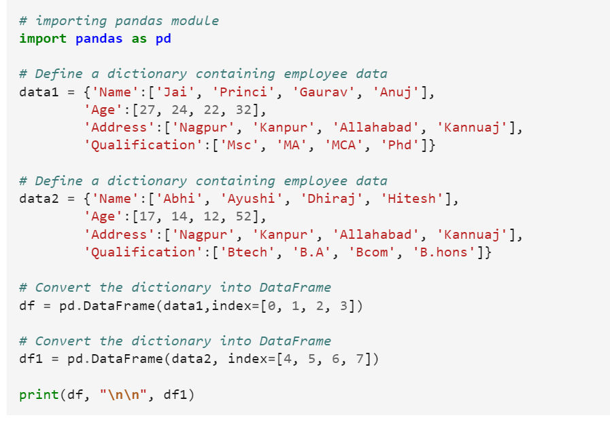

Slide 30
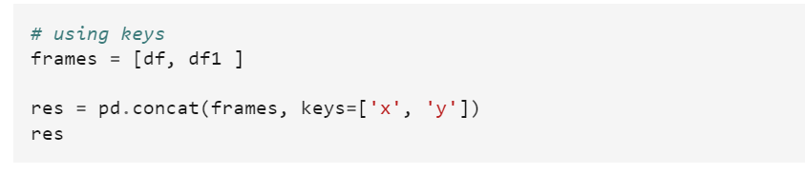
Now we use keys as an argument.

Slide 31
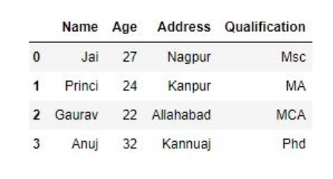
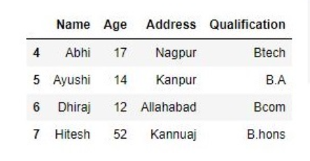
Output :

Slide 32
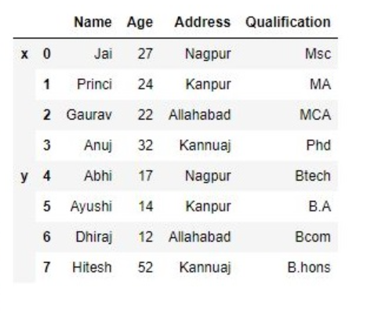

Slide 33
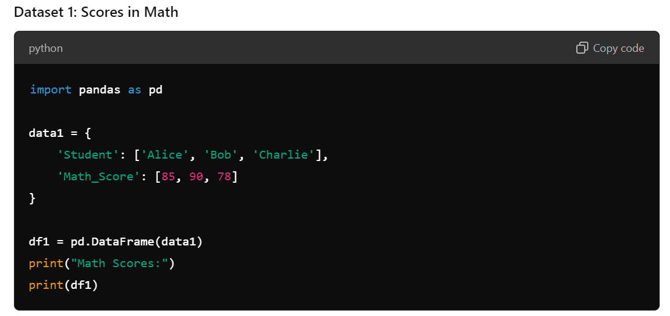
Concatenating Vertically

Slide 34
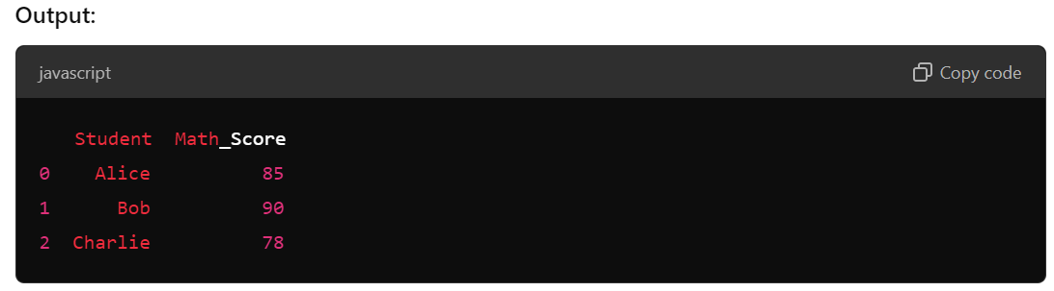

Slide 35
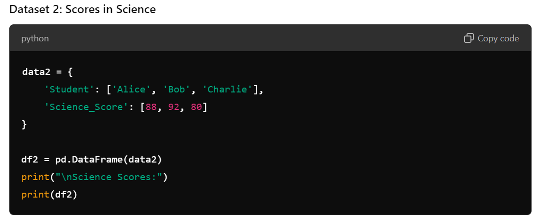

Slide 36
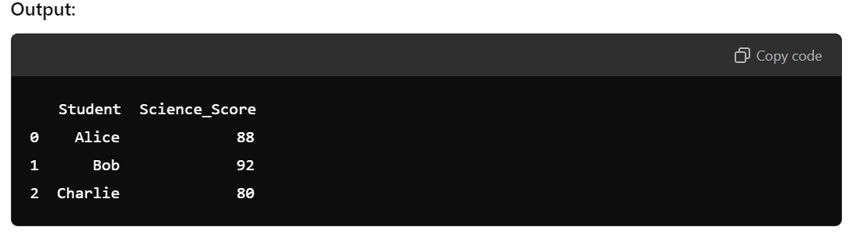

Slide 37
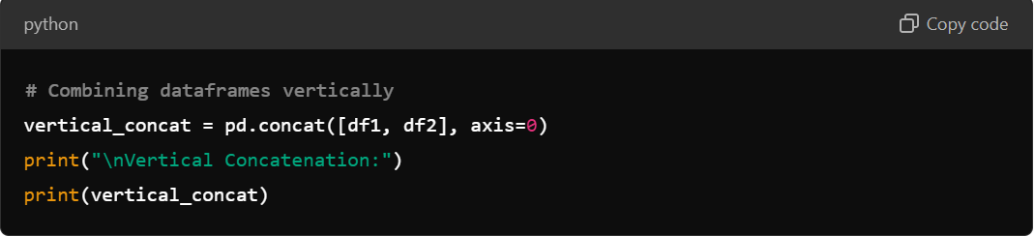
Concatenating Vertically : If you want to combine these two datasets vertically (adding rows), you can use pd.concat():

Slide 38
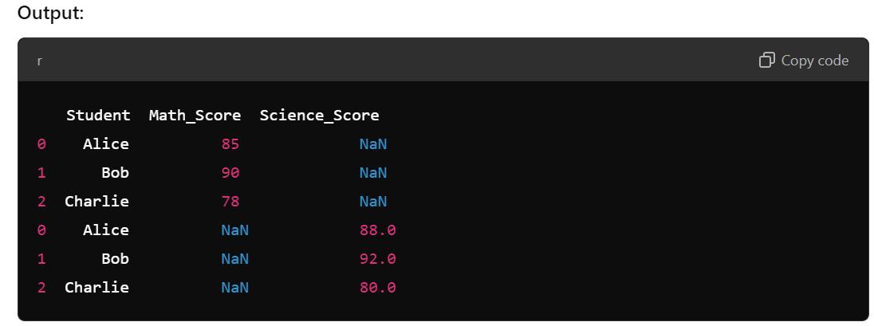

Slide 39
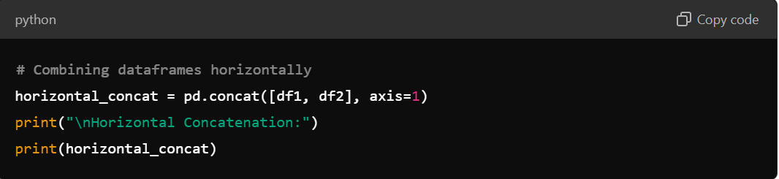
Concatenating HorizontallyTo combine them horizontally (adding columns), use axis=1:

Slide 40
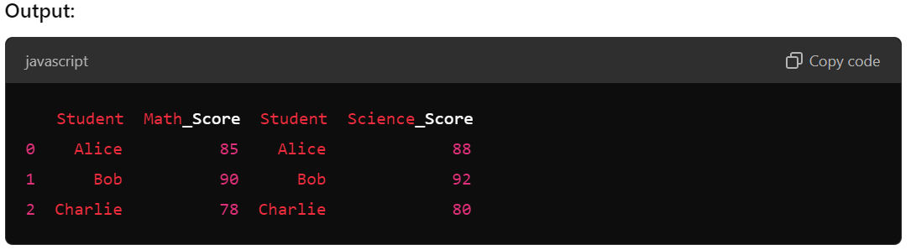

Slide 41
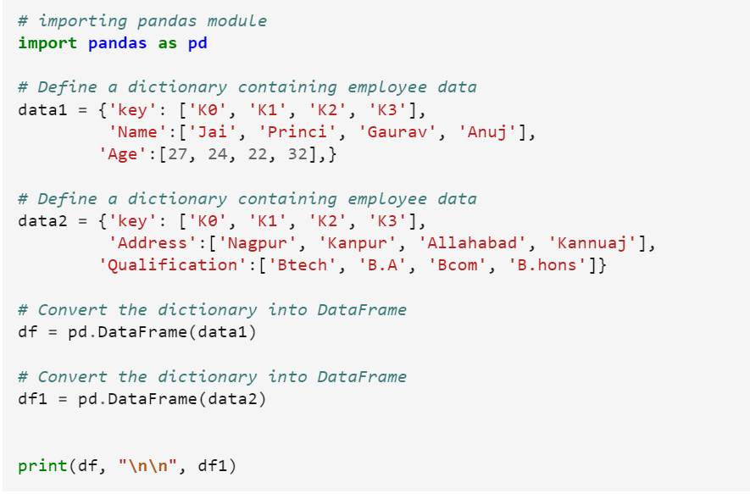
Merging DataFrame
Merging a dataframe with one unique key combination

Slide 42
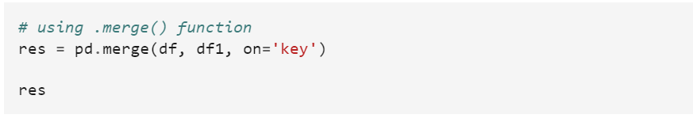
Now we are using .merge() with one unique key combination.

Slide 43
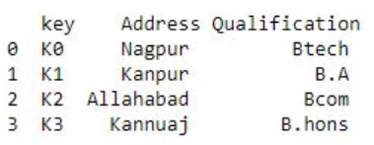
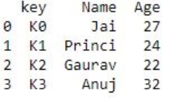
Output :

Slide 44
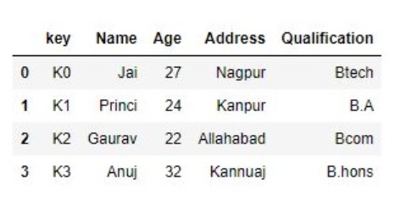

Slide 45
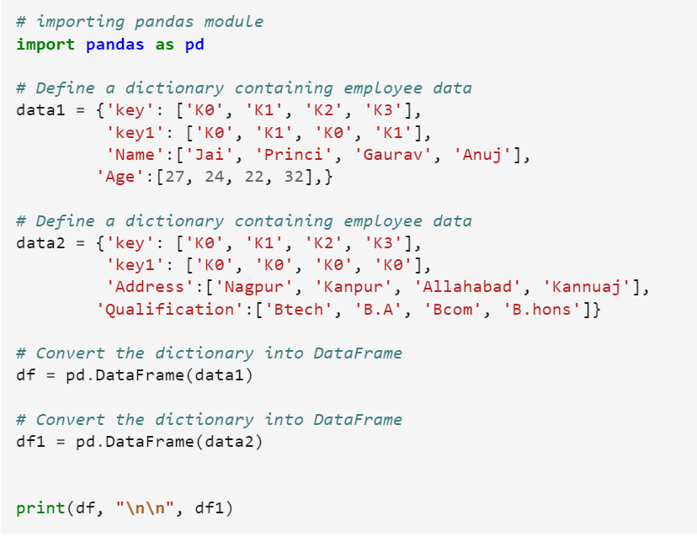
Merging dataframe using multiple join keys.

Slide 46
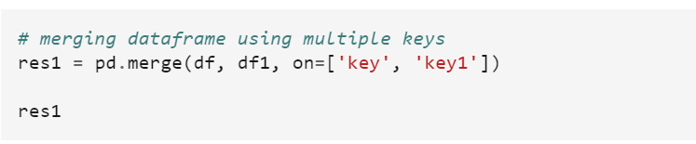
Now we merge dataframe using multiple keys.

Slide 47
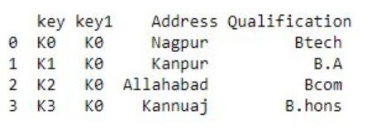
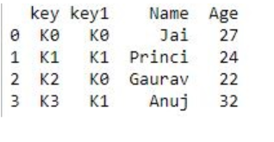
Output :

Slide 48
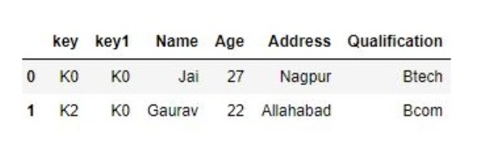

Slide 49
Merging dataframe using how in an argument:
We use how argument to merge specifies how to determine which keys are to be included in the resulting table. If a key combination does not appear in either the left or right tables, the values in the joined table will be NA. Here is a summary of the how options and their SQL equivalent names:

Slide 50
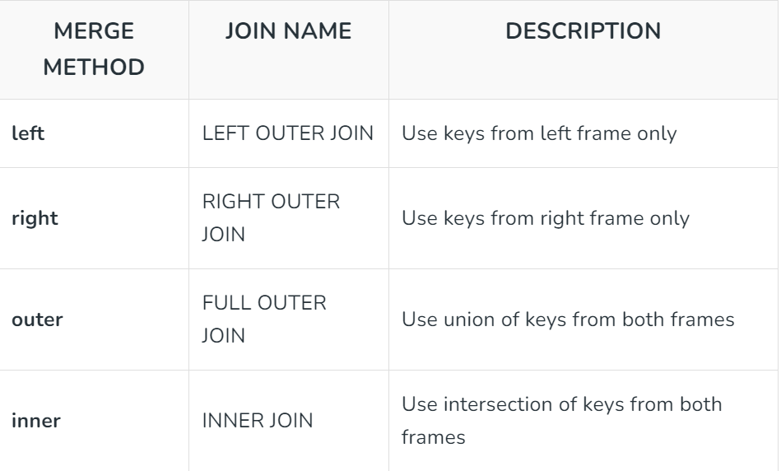

Slide 51
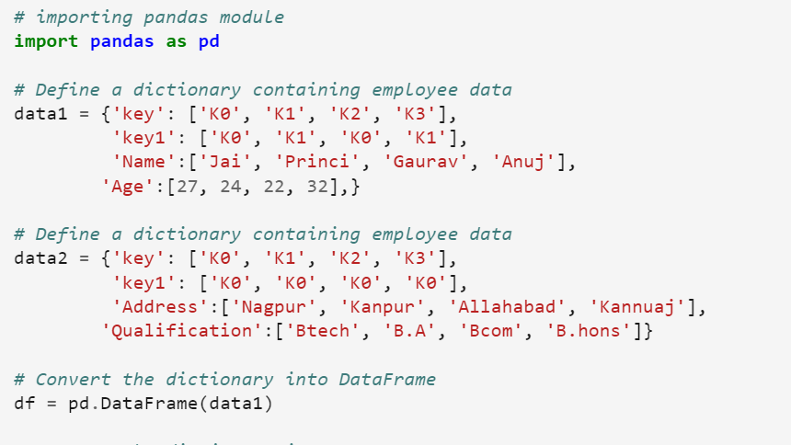

Slide 52
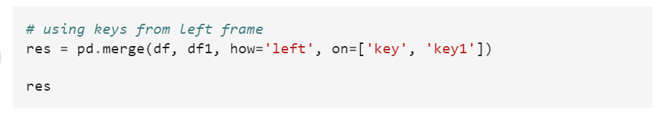
Now we set how = 'left' in order to use keys from left frame only.

Slide 53



Slide 54


Slide 55

Now we set how = 'right' in order to use keys from right frame only.

Slide 56


Output :

Slide 57


Slide 58

Now we set how = 'outer' in order to get union of keys from dataframes.

Slide 59


Output :

Slide 60


Slide 61

Now we set how = 'inner' in order to get intersection of keys from dataframes.

Slide 62


Output :

Slide 63


Slide 64
Joining DataFrame
When we need to combine very large DataFrames, joins serve as a powerful way to perform these operations swiftly. Joins can only be done on two DataFrames at a time, denoted as left and right tables. The key is the common column that the two DataFrames will be joined on.
There are four basic ways to handle the join (inner, left, right, and outer), depending on which rows must retain their data.

Slide 65


Slide 66
In order to join dataframe, we use .join() function this function is used for combining the columns of two potentially differently-indexed DataFrames into a single result DataFrame.

Slide 67


Slide 68

Now we are use .join() method in order to join dataframes

Slide 69


Output:

Slide 70


Slide 71

Now we use how = 'outer' in order to get union

Slide 72


Output:

Slide 73


Slide 74
Joining dataframe using on in an argument :
In order to join dataframes we use on in an argument. join() takes an optional on argument which may be a column or multiple column names, which specifies that the passed DataFrame is to be aligned on that column in the DataFrame.

Slide 75


Slide 76

Now we are using .join with “on” argument.

Slide 77


Output:

Slide 78


Slide 79
Joining singly-indexed DataFrame with multi-indexed DataFrame :
In order to join singly indexed dataframe with multi-indexed dataframe, the level will match on the name of the index of the singly-indexed frame against a level name of the multi-indexed frame.

Slide 80


Slide 81

Now we join singly indexed dataframe with multi-indexed dataframe.

Slide 82


Output:

Slide 83


Slide 84
Dealing with duplicate key during data merging
When you merge two datasets using a key, duplicate keys can lead to multiple rows in the resulting DataFrame. This may not always be desirable, as it can complicate analysis and data interpretation.
Overview of the Process:
Create DataFrames with duplicate keys.
Merge the DataFrames.
Handle duplicates by either aggregating or removing them.

Slide 85

Step 1: Create Sample DataFramesLet’s create two DataFrames: one with duplicate keys and one with unique keys.

Slide 86


Slide 87

Step 2: Merge the DataFramesNow, let’s merge the two DataFrames on the key column using an outer join to include all keys.

Slide 88

Output :
The merged DataFrame will look like this:

Slide 89

Step 3: Handle Duplicates
Option 1: Aggregating Duplicate ValuesYou can summarize the data for duplicate keys, for example by taking the mean of value1.

Slide 90

Output :
After AggregationThis will result in:

Slide 91

Option 2: Removing Duplicates
If you want to keep only one occurrence of each duplicate key:

Slide 92

Output :
This will give you:

Slide 93

Complete Example Code:
Here’s the complete code for all the steps:

Slide 94


Slide 95


Slide 96
Advantages
Data Integrity: Handling duplicates helps maintain the accuracy and integrity of the merged dataset, preventing misleading results.
Enhanced Analysis: Aggregating duplicates can provide more meaningful insights, such as average scores instead of individual entries.
Cleaner Data: Removing or addressing duplicates results in a cleaner, more manageable dataset that is easier to work with.

Slide 97
Disadvantages
Data Loss Risk: Removing duplicates without careful consideration may lead to loss of important data or context.
Increased Complexity: The process of identifying and handling duplicates adds complexity to the data merging workflow, requiring additional processing steps.
Potential Misinterpretation: Aggregating data may hide nuances and variations within the duplicates that could be relevant for specific analyses.

Slide 98
Dealing with mismatched keys during data merging
Dealing with mismatched keys during data merging involves addressing discrepancies that occur when combining two or more datasets based on a common identifier (key). Mismatched keys can result from differences in naming conventions, missing records, or data from different sources that do not align perfectly. Effectively managing these mismatches is crucial for ensuring data integrity and accuracy in analyses.

Slide 99

Example:
Consider two datasets:
Dataset A (Users)

Slide 100

Dataset B (Scores)

Slide 101

Merging Datasets:

Slide 102


Slide 103

Output

Slide 104
How to Deal with Mismatched Keys
Use Different Join Types:
Inner Join: Only includes rows with matching keys. This can lead to data loss if there are many mismatches.
Outer Join: Includes all rows from both datasets, filling in missing values with NaN.
Left Join: Includes all rows from the left dataset and only matching rows from the right dataset.
Right Join: Includes all rows from the right dataset and only matching rows from the left dataset.

Slide 105
Fill Missing Values:
After merging, you can fill NaN values with default values, like 0, "Unknown", or the mean/median of the column.
Identify and Clean Data:
Before merging, identify keys that are present in one dataset but not the other. You can clean or standardize the data to ensure consistency.
Standardize Keys:
Ensure that keys are in the same format across datasets (e.g., case sensitivity, leading/trailing spaces).

Slide 106
Advantages
Comprehensive Data Capture:
Outer joins ensure no data is lost during the merge, providing a full view of available data.
Flexibility in Analysis:
Handling mismatches allows for deeper analysis, enabling analysts to explore data gaps and their implications.
Improved Decision-Making:
A complete dataset enhances the quality of insights drawn from data analysis, leading to better business decisions.

Slide 107
Disadvantages
Increased Complexity:
Managing mismatched keys can complicate the data merging process, requiring additional steps and checks.
Data Quality Issues:
Filling missing values might lead to inaccurate conclusions if the default values do not reflect the true nature of the data.
Performance Overhead:
Merging large datasets, especially with many mismatches, can be resource-intensive and slow down processing times.

Slide 108
Advanced Merging Techniques:
Fuzzy Matching
Fuzzy matching is a technique used to identify strings that are similar but not exactly the same. This is particularly useful when merging datasets that may have inconsistencies due to typos, different formats, or variations in spelling.
Or

Slide 109

String matching or fuzzy matching is a method to find strings which match a given pattern or string approximately. It identifies the likelihood or probability that two records are true match based on some parameters. In the example shown below, the algorithms try to match the 5 different variations to the given string ‘Microsoft Corporation’ and score each of them based on how close they match the true value.

Slide 110
How Fuzzy Matching Works
Fuzzy matching typically employs algorithms that calculate a similarity score between two strings. The higher the score, the more similar the strings are. This enables matches even when the strings contain errors or differences.
Concept and Importance
Fuzzy matching enhances data quality by allowing flexible comparisons based on similarity rather than exact matches. This technique is widely used in applications like customer relationship management, record linkage, and natural language processing.
Common Algorithms for Fuzzy Matching
Several algorithms are employed in fuzzy matching, each with unique strengths:

Slide 111
Levenshtein Distance:
Definition: Measures the minimum number of single-character edits (insertions, deletions, substitutions) required to transform one string into another.
Use Case: Ideal for detecting small typographical errors. For example, it can match "Jon" to "John".
Jaccard Similarity:
Definition: Compares the size of the intersection of two sets to the size of their union.
Use Case: Effective for comparing text documents or phrases where the focus is on the presence of words.

Slide 112


Slide 113
Cosine Similarity:
Definition: Measures the cosine of the angle between two vectors in a multi-dimensional space.
Use Case: Commonly used in natural language processing to determine the similarity of documents.
Soundex and Metaphone:
Definition: Phonetic algorithms that convert words into codes based on how they sound.
Use Case: Useful for matching names that may be spelled differently but sound similar.

Slide 114
N-grams:
Definition: Breaks down strings into contiguous sequences of n characters or words.
Use Case: Helpful in text comparison where the sequence of characters is more significant than the overall structure.

Slide 115

Implementation in Python
The fuzzywuzzy library is a popular choice for implementing fuzzy matching in Python. Below is a complete example demonstrating its use.

Slide 116


Slide 117

Output:

Slide 118
Conclusion
Fuzzy matching is a powerful technique for improving data quality by allowing flexible string comparisons. By utilizing algorithms like Levenshtein distance and Jaccard similarity, it effectively addresses the challenges posed by imperfect data. Understanding and implementing these algorithms can significantly enhance data management practices and improve decision-making based on accurate datasets.

